Slide 1
Digital Image Processing
Associate Prof. Zhang Qingfeng(张庆丰)
Department of Computer Science, Jinan University
Office Room: 415, Nanhailou Building
Email: zqf135@qq.com
1

Slide 2
Chapter 5
Image Restoration and Reconstruction (I)
2

Slide 3
Contents
0. Preview
1. A Model of the Image Degradation / Restoration Process
2. Noise Models
3. Restoration in the Presence of Noise Only -Spatial Filtering
4. Periodic Noise Reduction by Frequency Domain Filtering
Summary
3

Slide 4
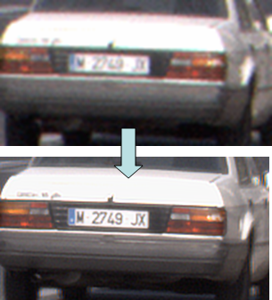
0. Preview
Degraded image
Due to imperfections of measuring devices (optical degradations, limited size of sensors, camera shake) and instability of observed scene (object motion, air turbulence), captured images are blurred, noisy and of insufficient spatial or temporal resolution. These images are called degraded images.

Slide 5
0. Preview
Image Restoration
attempts to recover an image that has been degraded（退化的） by using a priori（先验的） knowledge of the degradation phenomenon.
Goal of image restoration
Similar to image enhancement, the ultimate goal of restoration techniques is to improve an image in some predefined sense.
Technique Route
Restoration are oriented toward modeling the degradation;
Applying the inverse process to recover the original image.

Slide 6
0. Preview
Image restoration is an objective process
(1) It recovers the image using a priori knowledge of the degradation phenomenon
(2) Restoration techniques are oriented toward modeling the degradation and applying the inverse process to recover the original image
(3) involves formulating a criterion(准则) of goodness that will yield an optimal estimate of the desired result

Slide 7
Image restoration vs. image enhance
Enhancement:
largely a subjective process
A priori knowledge about the degradation is not a must (sometimes no degradation is involved)
Procedures are heuristic and take advantage of the psychophysical aspects of human visual system
Restoration:
For the most part, it is an objective process.
Images are degraded
Tries to recover the images by using the knowledge about the degradation

Slide 8
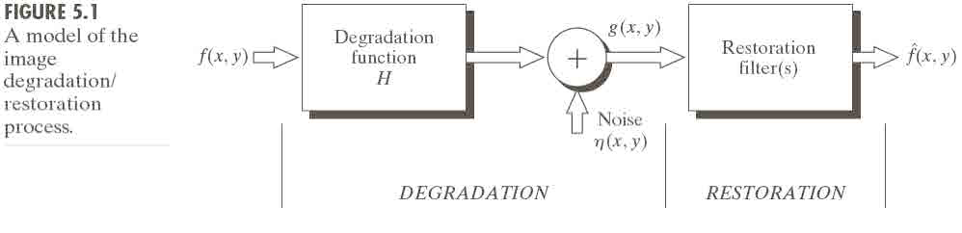
1. A Model of the Image Degradation/Restoration Process
If H is a linear, position-invariant process (filter), the degraded image is given in the spatial domain by
g(x,y) = h(x,y)★ f (x,y) + η(x,y)
whose equivalent frequency domain representation is
G(u,v) = H(u,v)F(u,v) + N(u,v)
8

Slide 9
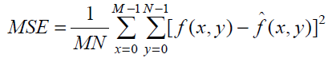
1. A Model of the Image Degradation/Restoration Process
The objective of restoration is to obtain an image estimate which is as close as possible to the original input image.
How to measure the goodness of optimal estimate of original image? A typical difference measurement is the mean square error (MSE):
Generally, the more H and noise are known, the lower MSE will become.

Slide 10
2. Noise Models
We first consider the degradation due to noise only h is an impulse for now ( H is a constant)
The principal sources of noise in digital images arise during:
Image acquisition: For instance, with a CCD camera, light levels and sensor temperature introduce noise to the resulting image.
Image transmission: For instance, an image transmitted over a wireless network might be corrupted as a result of lighting or other atmospheric disturbance.

Slide 11
2.1 Spatial and Frequency Properties of Noise
In the spatial domain, we are interested in the parameters that define the spatial characteristics of noise, and whether the noise is correlated with the image.
Frequency properties refer to the frequency content of noise in the Fourier sense. For example, when the Fourier spectrum of noise is constant, the noise usually is called white noise.

Slide 12
2.1 Spatial and Frequency Properties of Noise
In general, we assume that noise is independent of spatial coordinates and it is uncorrelated with respect to(w.r.t.) the image itself (i.e. no correlation between pixel values and the values of noise components).
Based on the assumptions, the spatial noise descriptor with which we shall be concerned is the statistical behavior of the intensity values in the noise component in the degradation mode.

Slide 13
2.2 Some Important Noise Probability Density Functions
Noises are taken as random variables. Random variables are characterized by a Probability Density Function (PDF 概率密度函数).
The following are the most common PDFs:
Gaussian noise
Rayleigh noise
Erlang (Gamma) noise
Exponential noise
Uniform noise
Impulse noise

Slide 14
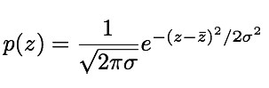
2.2 Some Important Noise Probability Density Functions
Gaussian noise （高斯噪声）
Because of its mathematical tractability（易处理） in both the spatial and frequency domains, Gaussian (normal) noise models are used frequently in practice.
The probability density function (PDF) of a Gaussian random variable, z , is given by
where z represents intensity, is the mean (average) value of z ,and σ is its standard deviation.
Notes:
tractability ˌtræktə‘bɪləti] ,驯良，听话，易处理

Slide 15
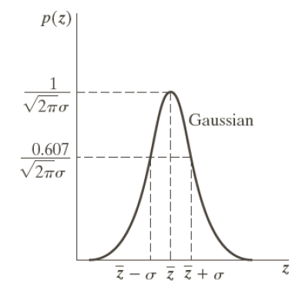
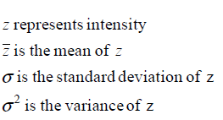
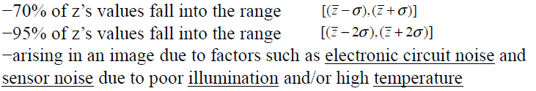
2.2 Some Important Noise Probability Density Functions

Slide 16
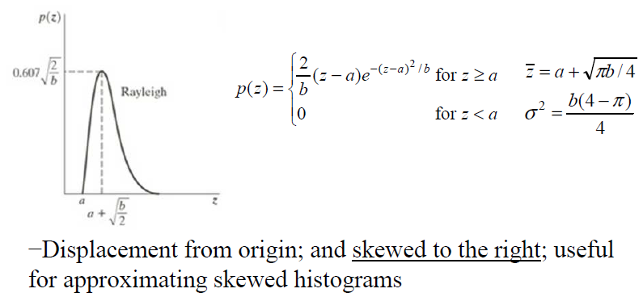
2.2 Some Important Noise Probability Density Functions
Rayleigh noise（瑞利噪声）

Slide 17
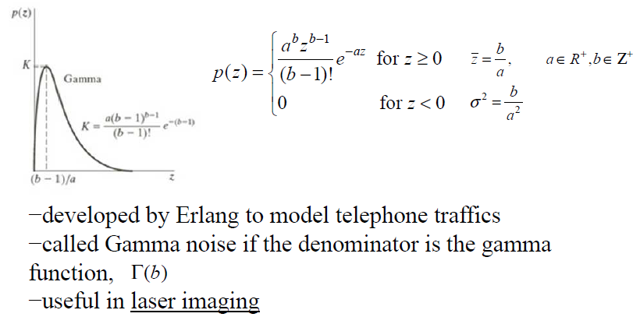
2.2 Some Important Noise Probability Density Functions
Erlang (gamma) noise （伽马噪声）

Slide 18
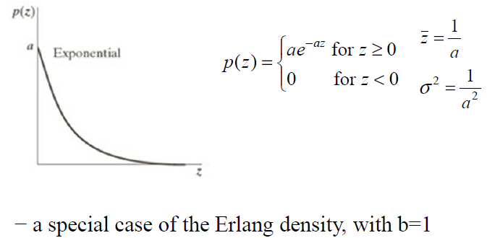
2.2 Some Important Noise Probability Density Functions
Exponential noise （指数噪声）

Slide 19
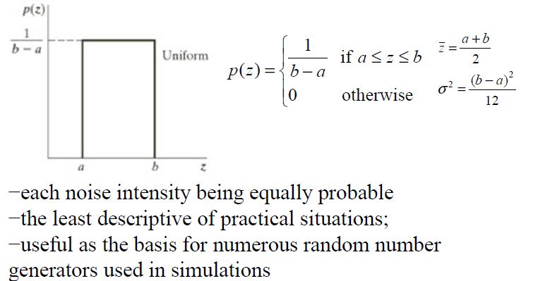
2.2 Some Important Noise Probability Density Functions
Uniform noise （均匀噪声）

Slide 20
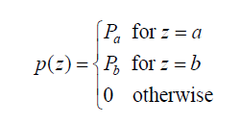
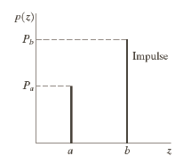
2.2 Some Important Noise Probability Density Functions
Impulse (salt-and-pepper ) noise 椒盐噪声
The PDF of impulse noise is given by
If b > a , intensity b appears as a light dot in the image. Conversely, intensity a will appear like a dark dot.

Slide 21
2.2 Some Important Noise Probability Density Functions
a and b usually are extreme
values because impulse corruption
is usually large compared with the
strength of the image signal
If either P_{a} or P_{b} is zero, the
impulse noise is called unipolar.
If neither P_{a} nor P_{b} is zero, and especially if they are approximately equal, the impulse noise values will resemble salt-and-pepper granules (椒盐颗粒) randomly distributed over the image.
21

Slide 22

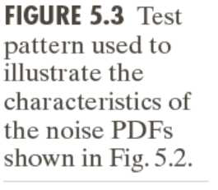
2.2 Some Important Noise Probability Density Functions
The figure shows a test pattern well suited for illustrating the noise models just discussed.
composed of simple constant areas that span the gray scale from black to near white in only three increments
facilitating visual analysis of the characteristics of the various noise components added to the image

Slide 23
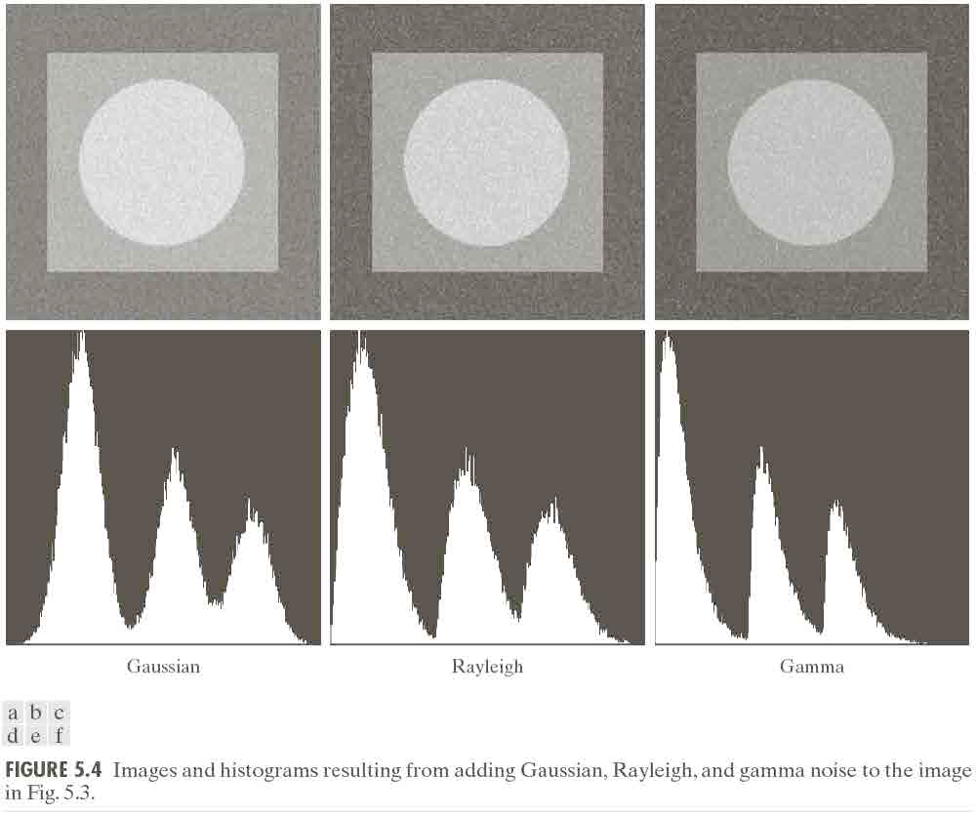
2.2 Some Important Noise Probability Density Functions

Slide 24
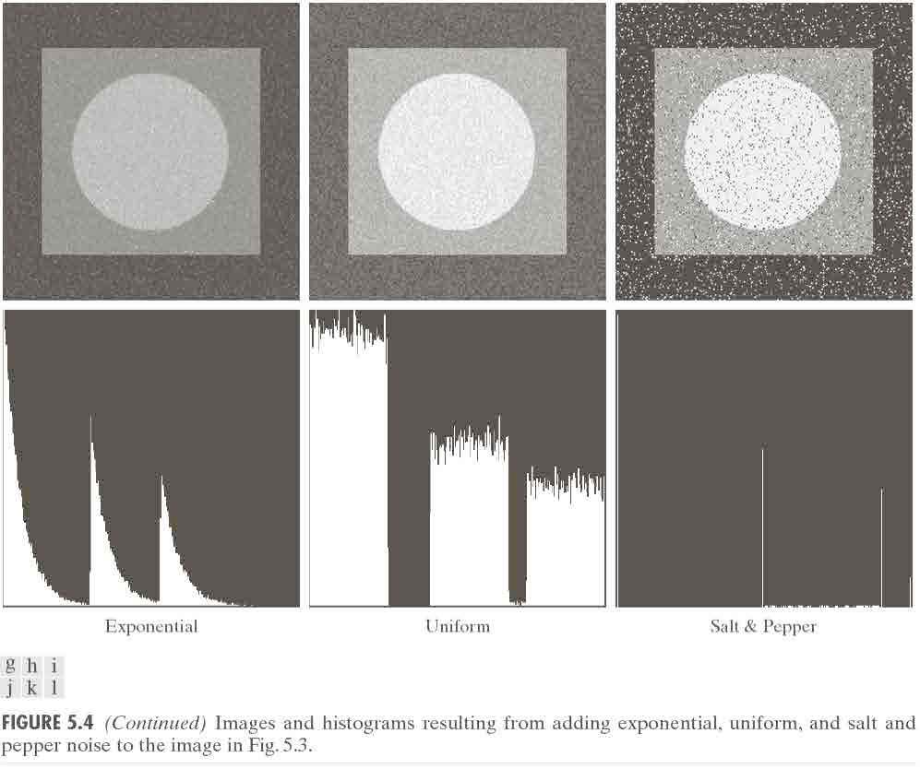
2.2 Some Important Noise Probability Density Functions

Slide 25
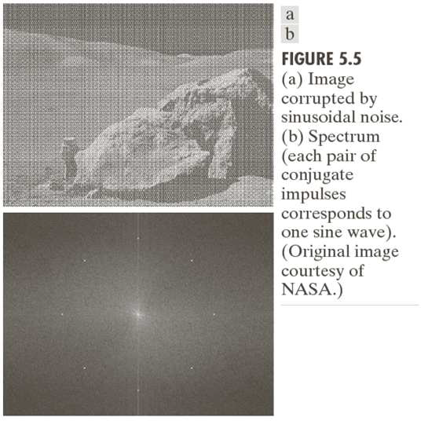
2.3 Periodic Noise （周期噪声）
Periodic noise in an image arises typically from electrical or electromechanical interference during image acquisition.
only spatially dependent noise considered herein
maybe reduced significantly via frequency domain filtering (Figure 5.5)
Sinusoidal noise: Complex conjugate pair in frequency domain

Slide 26
2.4 Estimation of Noise Parameters
The parameters of periodic noise
typically estimated by inspecting the image’s Fourier spectrum
Random noise with unknown PDFs
Case 1: imaging system is available
Capture images of “flat” environment
Case 2: noisy images available
Take a strip (small patch) from constant background area (e.g., the vertical strips of 150x20 pixels)
Draw the histogram and observe it
Measure the mean and variance

Slide 27
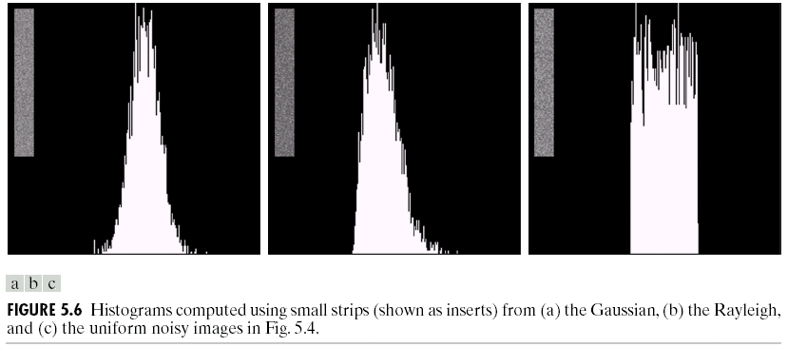
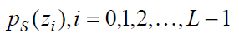
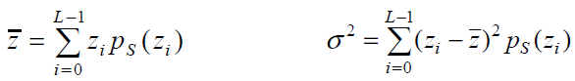
2.4 Estimation of Noise Parameters
Let S denote a strip and the probability estimates are denoted by
where L is the number of possible intensity in the entire image

Slide 28
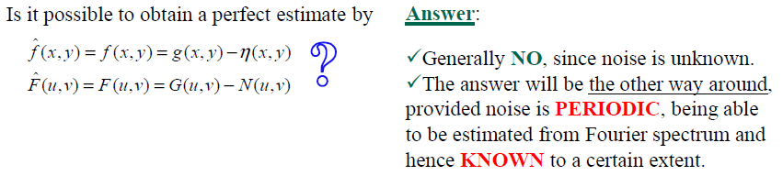
3. Restoration in the Presence of Noise Only - Spatial Filtering
When the only degradation present in an image is noise,
g(x,y) = h(x,y)★f (x,y) + η(x,y)
and G(u,v) = H(u,v)F(u,v) + N(u,v)
Become g(x,y) = f (x,y) + η(x,y)
and G(u,v) = F(u,v) + N(u,v)

Slide 29
3. Restoration in the Presence of Noise Only - Spatial Filtering
Spatial filtering is suitable when only additive random noise is present. Common spatial filters involves：
Mean Filters：Arithmetic mean filter；Geometric mean filter；Harmonic mean filter; Contraharmonic mean filter；
Order-Statistic Filters：Median filter；Max and min filters；Midpoint filter；Alpha-trimmed mean filter
Adaptive Filters：Adaptive, local noise reduction filter；Adaptive median filter
Notes:
Contraharmonic

Slide 30
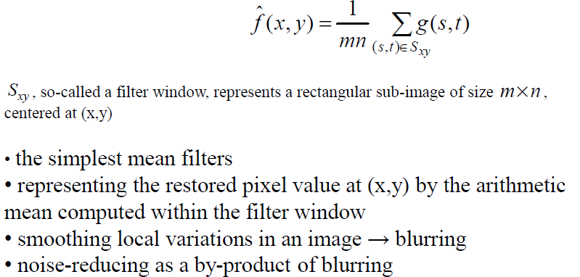
3.1 Mean Filters（均值滤波）
Arithmetic mean filter (算术均值滤波)

Slide 31
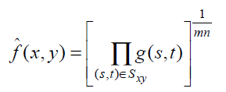
3.1 Mean Filters
Geometric mean filter （几何均值滤波）
each restored pixel value given by the product of all the pixel values in the filter window, raised to the power 1/mn
Achieving smoothing comparable to the arithmetic mean filter, but tending to lose less image detail in the process

Slide 32
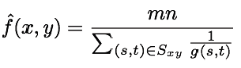
3.1 Mean Filters
Harmonic mean filter (谐波均值滤波)
working well for salt and Gaussian noises, but failing for pepper noise

Slide 33
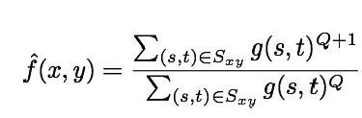
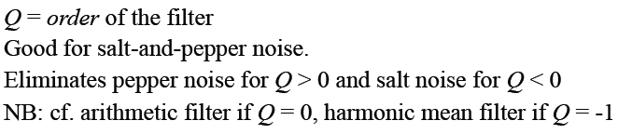
3.1 Mean Filters
Contraharmonic mean filter (逆谐波均值滤波)
Notes:
cf. 参见，参看，比较。 是拉丁语confer的简写

Slide 34
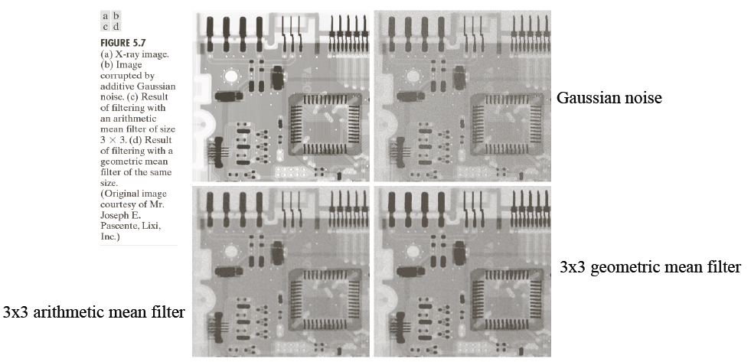
3.1 Mean Filters

Slide 35
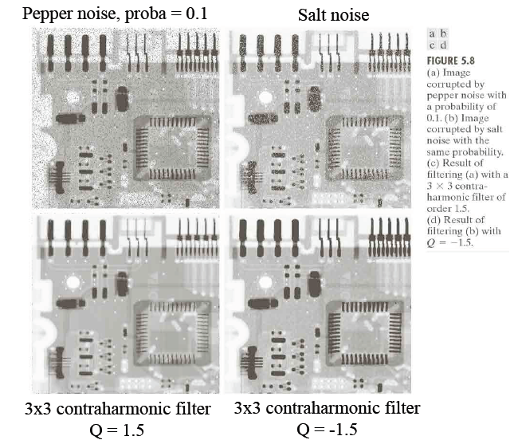
3.1 Mean Filters

Slide 36
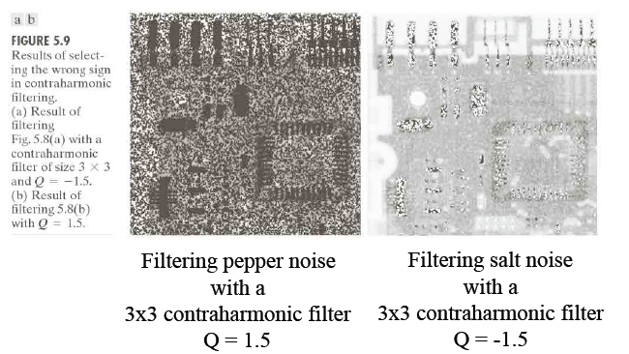
3.1 Mean Filters

Slide 37
3.2 Order-Statistic Filters（排序统计滤波）
As discussed in Chapter 3, order-statistic filters （OSF）are spatial filters
whose response is based on ordering (ranking) the values of the pixels contained in the image area encompassed by the filter.

Slide 38
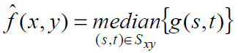
3.2 Order-Statistic Filters（排序统计滤波）
Median filter （中值滤波）
the best-known of order-statistic filters
representing the restored pixel value at (x,y) by the median (ranked in the 50th percentile) of intensity levels in the filter window
particularly effective in the presence of both bipolar and unipolar impulse noise

Slide 39
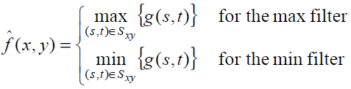
3.2 Order-Statistic Filters（排序统计滤波）
Max and min filters (最大最小滤波)
representing the restored pixel value at (x,y) by the maximum/minimum of intensity levels in the filter window
the max filter greatly reducing pepper noise (black dots)
the min filter greatly reducing salt noise (white dots)

Slide 40
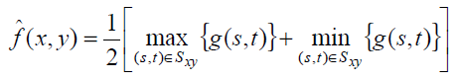
3.2 Order-Statistic Filters（排序统计滤波）
Midpoint filter （中点滤波）
representing the restored pixel value at (x,y) by the midpoint between the darkest and brightest points in the filter window
working best for randomly distributed noise, e.g., Gaussian or uniform noise

Slide 41
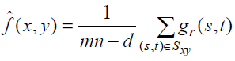
3.2 Order-Statistic Filters（排序统计滤波）
Alpha-trimmed mean filter (阿尔法修正均值滤波)
g_{r} (x, y) representing the trimmed filter window of size (mn-d) after deleting the d/2 lowest and the d/2 highest values out of the original filter window
becoming a median filter when d = mn -1
efficiently handling mixture noise, e.g., a combination of salt-and-pepper and Gaussian noise

Slide 42
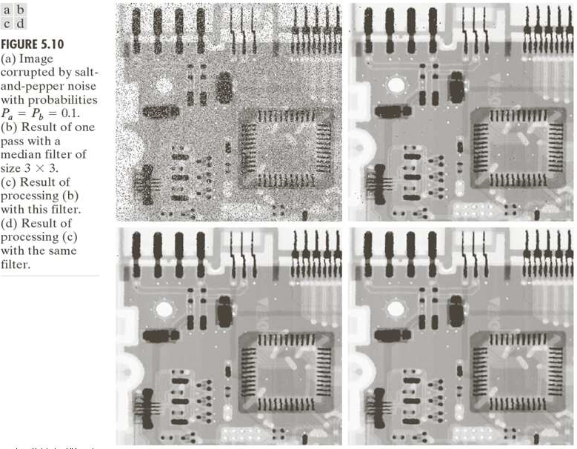
Illustration of order-statistic filters

Slide 43
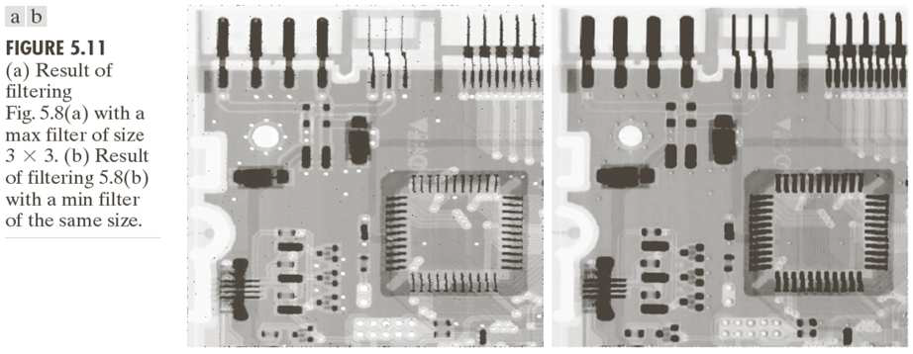
Illustration of order-statistic filters

Slide 44
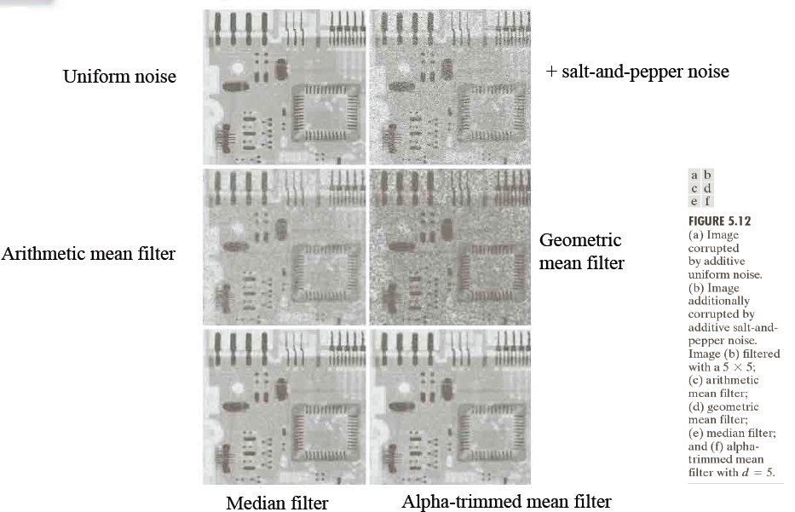
Illustration of order-statistic filters

Slide 45
4 Periodic Noise Reduction by Frequency Domain Filtering
Periodic noise appears as concentrated bursts of energy in the FT, at locations corresponding to the frequencies of the periodic interference
Approach: use a selective filter to isolate the noise
Three types of selective filters will be discussed:
Bandreject Filters
Bandpass Filters
Notch Filters : reject (or pass) frequencies in predefined neighbourhoods about a center frequency

Slide 46
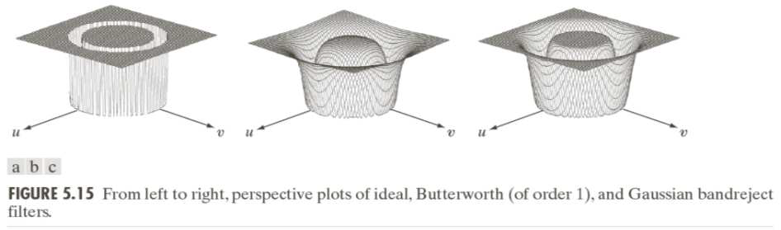
4 Periodic Noise Reduction by Frequency Domain Filtering
Band-reject Filters （带阻滤波）
Suitable for noise removal when the noise component(s) in the frequency domain is approximately known

Slide 47
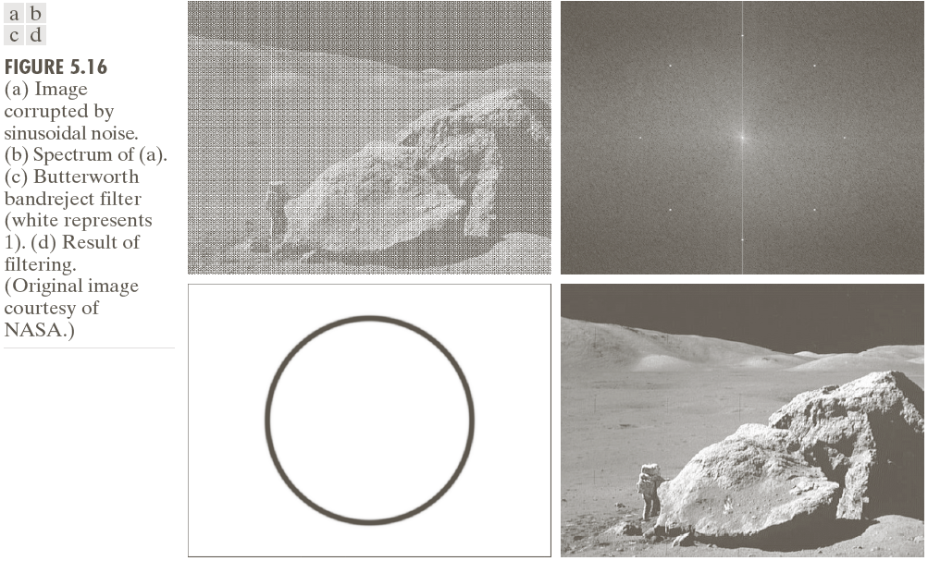
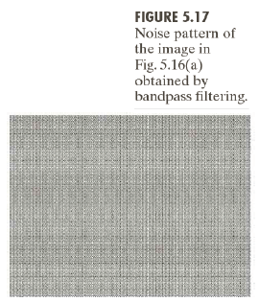
4 Periodic Noise Reduction by Frequency Domain Filtering

Slide 48
4 Periodic Noise Reduction by Frequency Domain Filtering
Bandpass (BP) Filters （带通滤波）
performing the opposite operation of bandreject (BR) filters.
which can be obtained from those of corresponding bandreject filters
H_{BP} (u,v) =1-H_{BR} (u,v)

Slide 49
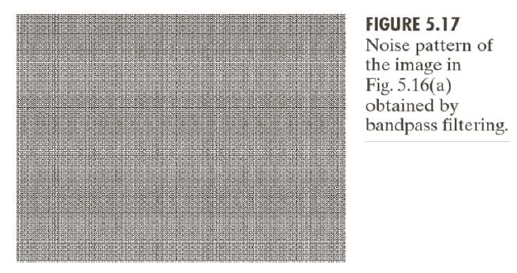
4 Periodic Noise Reduction by Frequency Domain Filtering
Figure 5.17 generated by
1) Obtaining the bandpass filter corresponding to the bandreject filter used in Fig. 5.16
2) Taking the inverse transform of the bandpass-filtered transform

Slide 50
4 Periodic Noise Reduction by Frequency Domain Filtering
Notch Filters （陷波滤波）
Either rejecting (NR) or passing (NP) frequencies in predefined neighborhoods about a center frequency.
The transfer functions of NP and NR have the following relationship
HNP (u,v) =1-HNR (u,v)

Slide 51
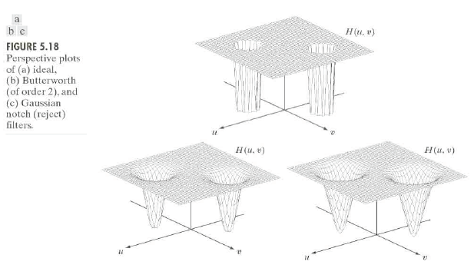
4 Periodic Noise Reduction by Frequency Domain Filtering

Slide 52
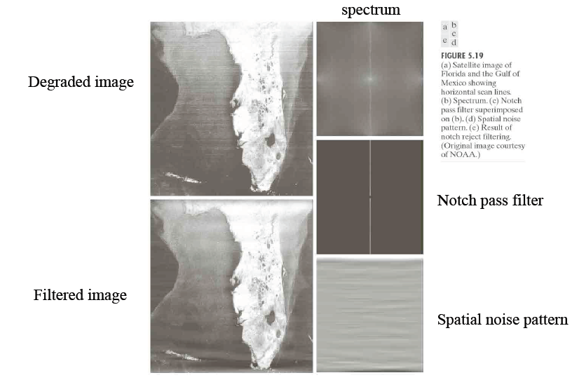
4 Periodic Noise Reduction by Frequency Domain Filtering

Slide 53
Summary
In this lecture, we have learned
The model of the Image Degradation / Restoration Process
Several Noise Models
Restoration in the Presence of Noise Only -Spatial Filtering
Periodic Noise Reduction by Frequency Domain Filtering
53

